Slide 1
Assessment of On Job Training-1
At x-workz

Slide 2
Role of intern in organization
An intern’s goal is to gain practical experience and learning within a specific field or industry. Their goal is to perform assigned tasks, learn about an organizations ways of working. Internship offers valuable opportunities for skill development, communication,& solve real world problems.

Slide 3
Technical knowledge during OJT-1
HTML
CSS
Github

Slide 4
HTML
HTML (Hypertext Markup Language) is the foundation of web development, serving as the standard markup language used to create and structure web pages. The first version of HTML was written by Tim Berners-Lee in 1993

Slide 5
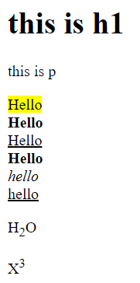
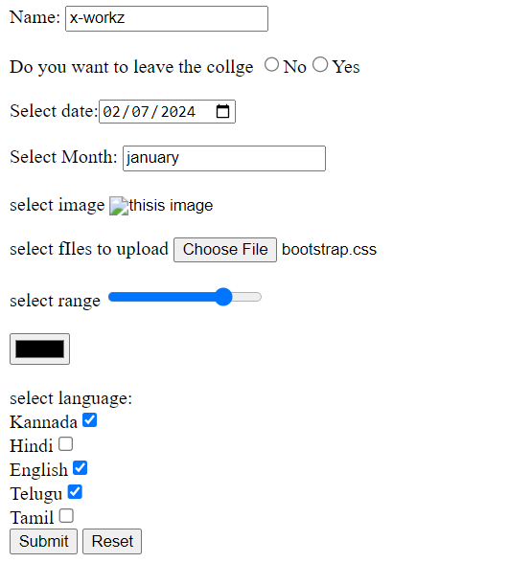
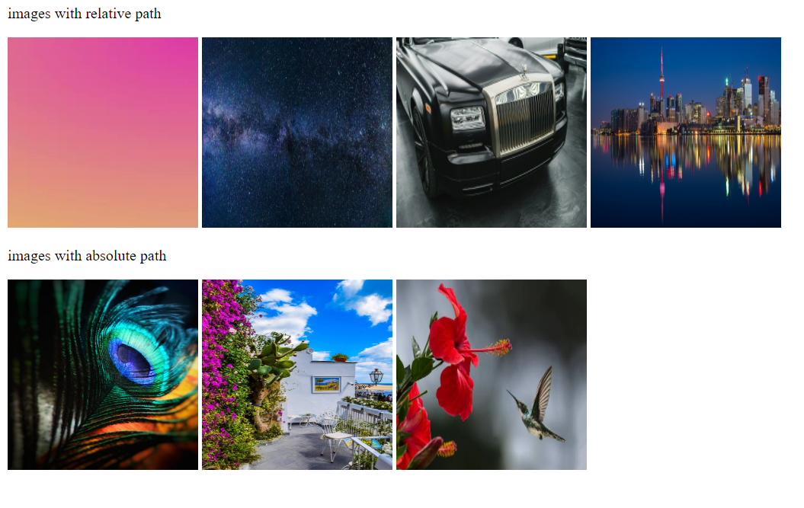
HTML use case

Slide 6
CSS
CSS (Cascading Style Sheets) is a stylesheet language used to control the presentation and formatting of web pages written in HTML

Slide 7
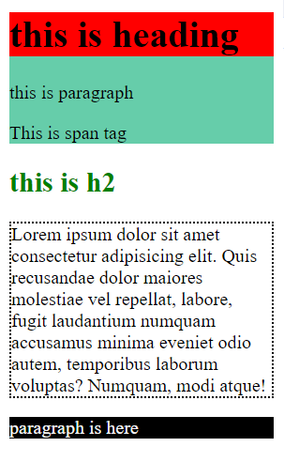
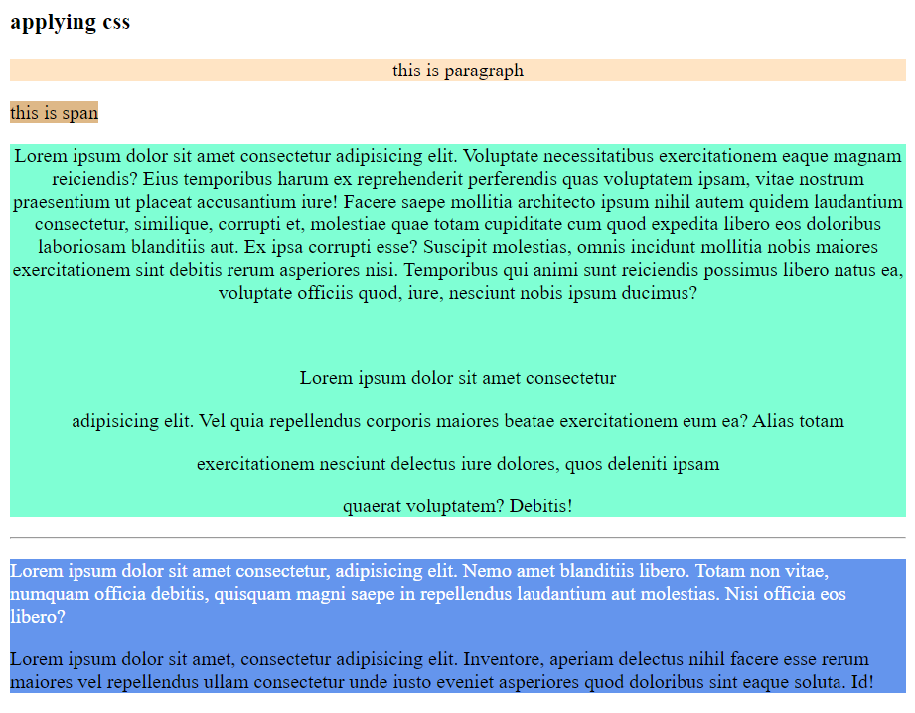
CSS use case

Slide 8
Github
GitHub is a web-based platform and service that provides hosting for software development projects using the Git version control system.
GitHub has become an essential tool for software development, offering a platform for collaboration, version control, and project management that empowers developers to build and maintain high-quality software projects effectively.

Slide 9
Github commands
git clone
git add
git status
git commit
git push

Slide 10
Gitbash
Gitbash configuration
Token authentication
$git config --global user.email<your email>
$git config --global user.password <password>
These commands will configure Gitbash to connect to your github account use password or token for authentication
Token authentication in Github involves using a personal access token to authenticate your self when interacting with API or via command line.
This substitutes as your password and provides a more secure way to authenticate without exposing your actual credentials

Slide 11
Summary
HTML - It defines the structures of the web page
CSS – It is used to style, add color, and position html elements
Github – It is a remote cloud storage which makes development easier

Slide 12
Thank you!

